Slide 1
Chapter 6 – Graphical User Interfaces
Java Foundations:
Introduction to Programming and Data Structures
by John Lewis,
Peter DePasquale and Joseph Chase

Slide 2
Graphical User Interfaces
Many programs provide graphical user interfaces (GUI) through which a user interacts
Chapter 6 focuses on
  discussing the core elements: components, events, and listeners
  discussing the concept of a layout manager
  examining mouse and keyboard events
  describing tool tips and mnemonics
  discussing GUI design issues

Slide 3
Outline
GUI Elements
More Components
Layout Managers
Mouse and Key Events
Dialog Boxes
Important Details
GUI Design

Slide 4
6.1 – GUI Elements
Examples from previous chapters are known as command-line applications, which interact with the user through simple prompts and feedback
Command-line applications lack the rich user experience
With GUI, the user is not limited to responding to prompts in a particular order and receiving feedback in one place

Slide 5
6.1 – GUI Elements
Three kinds of objects are needed to create a GUI in Java
  components
  events
  listeners
Component – an object that defines a screen element used to display information or allow the user to interact with the program
  A container is a special type of component that is used to hold and organize other components

Slide 6
6.1 – GUI Elements
Event – an object that represents some occurrence in which we may be interested
  Often correspond to user actions (mouse button press, keyboard key press)
  Most GUI components generate events to indicate a user action related to that component
  Program that is oriented around GUI, responding to user events is called event-driven

Slide 7
6.1 – GUI Elements
Listener – an object that “waits” for an event to occur and responds in way when it does
  In designing a GUI-based program we need to establish the relationships between the listener, the event it listens for, and the component that generates the event
In this textbook, we use existing components and events from the Java class library.
We will, however, write our own listener classes to perform whatever actions we desire when events occur

Slide 8
6.1 – GUI Elements
To create a Java program that uses a GUI, we must:
  instantiate and set up the necessary components,
  implement listener classes that define what happens when particular events occur, and
  establish the relationship between the listeners and the components that generate the events of interest
Java components and other GUI-related classes are defined primarily in two packages
  java.awt
  javax.swing

Slide 9
6.1 – GUI Elements
The Abstract Window Toolkit (AWT) was the original Java GUI package
  contains many important classes we will use
The Swing package was added later
  provides components that are more versatile than those of AWT
Let’s look at a simple example that contains all of the basic GUI elements
  the example presents the user with a single push button
  each time the button is pushed, a counter is updated and displayed

Slide 10
6.1 – PushCounter.java
//********************************************************************
// PushCounter.java Java Foundations
//
// Demonstrates a graphical user interface and an event listener.
//********************************************************************
import javax.swing.JFrame;
public class PushCounter
{
//-----------------------------------------------------------------
// Creates and displays the main program frame.
//-----------------------------------------------------------------
public static void main (String[] args)
{
JFrame frame = new JFrame ("Push Counter");
frame.setDefaultCloseOperation (JFrame.EXIT_ON_CLOSE);
PushCounterPanel panel = new PushCounterPanel();
frame.getContentPane().add(panel);
frame.pack();
frame.setVisible(true);
}
}

Slide 11
6.1 – PushCounterPanel.java
//********************************************************************
// PushCounterPanel.java Java Foundations
//
// Demonstrates a graphical user interface and an event listener.
//********************************************************************
import java.awt.*;
import java.awt.event.*;
import javax.swing.*;
public class PushCounterPanel extends JPanel
{
private int count;
private JButton push;
private JLabel label;
(more…)

Slide 12
6.1 – PushCounterPanel.java
//-----------------------------------------------------------------
// Constructor: Sets up the GUI.
//-----------------------------------------------------------------
public PushCounterPanel ()
{
count = 0;
push = new JButton ("Push Me!");
push.addActionListener (new ButtonListener());
label = new JLabel ("Pushes: " + count);
add (push);
add (label);
setBackground (Color.cyan);
setPreferredSize (new Dimension(300, 40));
}
(more…)

Slide 13
6.1 – PushCounterPanel.java
//*****************************************************************
// Represents a listener for button push (action) events.
//*****************************************************************
private class ButtonListener implements ActionListener
{
//--------------------------------------------------------------
// Updates the counter and label when the button is pushed.
//--------------------------------------------------------------
public void actionPerformed (ActionEvent event)
{
count++;
label.setText("Pushes: " + count);
}
}
}
Can access the instance variables count and label

Slide 14

6.1 – Push Counter Application

Slide 15
6.1 – GUI Elements
We classify containers as either
  heavyweight – managed by the underlying operating system
    examples: a frame, an applet (used to display and execute a Java application through a Web browser)
  lightweight – managed by the Java program
    example: a panel
    more complex than heavyweight containers
Generally, we can create a GUI-based application by creating a frame in which the program interface is displayed

Slide 16
6.1 – GUI Elements
Notes on our example
  In the main method, the frame for the program is constructed, set up, and displayed
  the call to the setDefaultCloseOperation method determines what will happen when the close button in the corner of the frame is clicked
  the content pane of the frame is obtained using the getContentPane method
  the content pane’s add method is used to add the panel

Slide 17
6.1 – GUI Elements
Notes on our example:
  the panel contains our button and text label
  a panel’s add method allows a component to be added to the panel
  a container is governed by a layout manager
  the default layout manager for a panel simply displays components in the order they are added, with as many components on one line as possible
  the pack method of the frame sets the frame size accordingly

Slide 18
6.1 – Buttons and Action Events
PushCounter displays
  label - displays a line of text
    can be used to also display an image
    labels are non-interactive
  push button – allows the user to initiate an action with a press of the mouse
    generates an action event
    different components generate different types of events
ButtonListener class represents the action listener for the button

Slide 19
6.1 – Buttons and Action Events
ButtonListener class was created as an inner class – a class defined inside of another class
Inner classes have access to the members of the class that contains it
Listener classes are written by implementing an interface (list of methods the implementing class must implement)
The ButtonListener implements the ActionListener interface

Slide 20
6.1 – Buttons and Action Events
ActionListener interface
  only method listed is the actionPerformed method
  the button component generates the action event resulting in a call to the actionPerformed method, passing an ActionEvent object
In the example, when the event occurs, the counter is incremented, and the label is updated (via the label’s setText method)

Slide 21
6.1 – Determining Event Sources
In the next example, we use one listener to listen to two different components
The example contains one label and two buttons
  push the Left button and the label says “Left”
  push the Right button, and the label says “Right”
The LeftRightPanel class creates one listener and applies it to both buttons
When either button is pressed, the actionPerfomed method of the listener is invoked.

Slide 22
6.1 – Determining Event Sources
One each invocation, the actionPerformed method uses an if-else statement to determine which button was pushed
The getSource method returns a reference to the component that generated the event
We could have created two listener classes. Then the actionPerformed method would not have to determine where the event is originating

Slide 23
6.1 – LeftRight.java
//********************************************************************
// LeftRight.java Java Foundations
//
// Demonstrates the use of one listener for multiple buttons.
//********************************************************************
import javax.swing.JFrame;
public class LeftRight
{
//-----------------------------------------------------------------
// Creates and displays the main program frame.
//-----------------------------------------------------------------
public static void main (String[] args)
{
JFrame frame = new JFrame ("Left Right");
frame.setDefaultCloseOperation (JFrame.EXIT_ON_CLOSE);
frame.getContentPane().add(new LeftRightPanel());
frame.pack();
frame.setVisible(true);
}
}

Slide 24
6.1 – LeftRightPanel.java
//********************************************************************
// LeftRightPanel.java Java Foundations
//
// Demonstrates the use of one listener for multiple buttons.
//********************************************************************
import java.awt.*;
import java.awt.event.*;
import javax.swing.*;
public class LeftRightPanel extends JPanel
{
private JButton left, right;
private JLabel label;
private JPanel buttonPanel;
(more…)

Slide 25
6.1 – LeftRightPanel.java
//-----------------------------------------------------------------
// Constructor: Sets up the GUI.
//-----------------------------------------------------------------
public LeftRightPanel ()
{
left = new JButton ("Left");
right = new JButton ("Right");
ButtonListener listener = new ButtonListener();
left.addActionListener (listener);
right.addActionListener (listener);
label = new JLabel ("Push a button");
buttonPanel = new JPanel();
buttonPanel.setPreferredSize (new Dimension(200, 40));
buttonPanel.setBackground (Color.blue);
buttonPanel.add (left);
buttonPanel.add (right);
setPreferredSize (new Dimension(200, 80));
setBackground (Color.cyan);
add (label);
add (buttonPanel);
}
(more…)

Slide 26
6.1 – LeftRightPanel.java
//*****************************************************************
// Represents a listener for both buttons.
//*****************************************************************
private class ButtonListener implements ActionListener
{
//--------------------------------------------------------------
// Determines which button was pressed and sets the label
// text accordingly.
//--------------------------------------------------------------
public void actionPerformed (ActionEvent event)
{
if (event.getSource() == left)
label.setText("Left");
else
label.setText("Right");
}
}
}

Slide 27
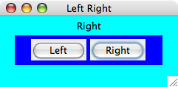
6.1 – Left Right Application

Slide 28
Outline
GUI Elements
More Components
Layout Managers
Mouse and Key Events
Dialog Boxes
Important Details
GUI Design

Slide 29
6.2 – More Components
In addition to push buttons, there are variety of other interactive components
  text fields – allows the user to enter typed input from the keyboard
  check boxes – a button that can be toggled on or off using the mouse (indicates a boolean value is set or unset)
  radio buttons – used with other radio buttons to provide a set of mutually exclusive options
  sliders – allows the user to specify a numeric value within a bounded range
  combo boxes – allows the user to select one of several options from a “drop down” menu
  timers – helps us manage an activity over time, has no visual representation

Slide 30
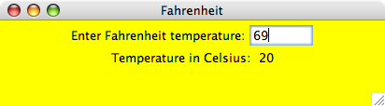
6.2 – Fahrenheit Application

Slide 31
6.2 – Text Fields
A text field generates an action event when the Enter or Return key is pressed (and the cursor is in the field)
Note that the push button and the text field generate the same kind of event – an action event
An alternative implementation could involve adding a push button to the panel which causes the conversion to occur when the user pushes the button

Slide 32
6.2 – Check Boxes
A check box generates an item event when it changes state from selected (checked) to deselected (unchecked) and vice versa
In the example, we use the same listener to handle both check boxes (bold and italic)
The example also uses the Font class to display and change the text label
Style of the font is represented as an integer, integer constants defined in the class are used to represent aspects of style
The JCheckBox class is used to define check boxes

Slide 33
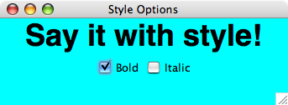
6.2 – Style Options Application

Slide 34
6.2 – StyleOptions.java
//********************************************************************
// StyleOptions.java Java Foundations
//
// Demonstrates the use of check boxes.
//********************************************************************
import javax.swing.JFrame;
public class StyleOptions
{
//-----------------------------------------------------------------
// Creates and displays the style options frame.
//-----------------------------------------------------------------
public static void main (String[] args)
{
JFrame frame = new JFrame ("Style Options");
frame.setDefaultCloseOperation (JFrame.EXIT_ON_CLOSE);
frame.getContentPane().add (new StyleOptionsPanel());
frame.pack();
frame.setVisible(true);
}
}

Slide 35
6.2 – StyleOptionsPanel.java
//********************************************************************
// StyleOptionsPanel.java Java Foundations
//
// Demonstrates the use of check boxes.
//********************************************************************
import javax.swing.*;
import java.awt.*;
import java.awt.event.*;
public class StyleOptionsPanel extends JPanel
{
private JLabel saying;
private JCheckBox bold, italic;
(more…)

Slide 36
6.2 – StyleOptionsPanel.java
//-----------------------------------------------------------------
// Sets up a panel with a label and some check boxes that
// control the style of the label's font.
//-----------------------------------------------------------------
public StyleOptionsPanel()
{
saying = new JLabel ("Say it with style!");
saying.setFont (new Font ("Helvetica", Font.PLAIN, 36));
bold = new JCheckBox ("Bold");
bold.setBackground (Color.cyan);
italic = new JCheckBox ("Italic");
italic.setBackground (Color.cyan);
StyleListener listener = new StyleListener();
bold.addItemListener (listener);
italic.addItemListener (listener);
add (saying);
add (bold);
add (italic);
setBackground (Color.cyan);
setPreferredSize (new Dimension(300, 100));
}
(more…)

Slide 37
6.2 – StyleOptionsPanel.java
//*****************************************************************
// Represents the listener for both check boxes.
//*****************************************************************
private class StyleListener implements ItemListener
{
//--------------------------------------------------------------
// Updates the style of the label font style.
//--------------------------------------------------------------
public void itemStateChanged (ItemEvent event)
{
int style = Font.PLAIN;
if (bold.isSelected())
style = Font.BOLD;
if (italic.isSelected())
style += Font.ITALIC;
saying.setFont (new Font ("Helvetica", style, 36));
}
}
}

Slide 38
6.2 – Radio Buttons
A radio button is used with other radio buttons to provide a set of mutually exclusive options
Radio buttons have meaning only when used with one or more other radio buttons
At any point in time, only one button of the group is selected (on)
Radio buttons produce an action event when selected
Radio buttons are defined by the JRadioButton class
The ButtonGroup class is used to define a set of related radio buttons

Slide 39
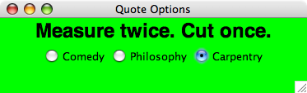
6.2 – Quote Options Application

Slide 40
6.2 - Sliders
Sliders allow the user to specify a numeric value within a bounded range
A slider can be presented either vertically or horizontally
Optional features include
  tick marks on the slider
  labels indicating the range of values
A slider produces a change event, indicating that the position of the slider and the value it represents has changed
A slider is defined by the JSlider class

Slide 41
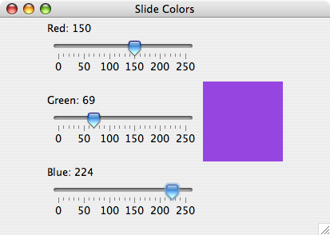
6.2 – Slide Colors Application

Slide 42
6.2 – Combo Boxes
A combo box allows a user to select one of several options from a “drop down” menu
When the user presses a combo box using a mouse, a list of options is displayed from which the user can choose
A combo box is defined by the JComboBox class
Combo boxes generate an action event whenever the user makes a selection from it

Slide 43
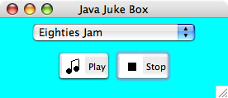
6.2 – Juke Box Application

Slide 44
6.2 - Timers
Timers do not have a visual representation, but are a GUI component
Timers are defined by the Timer class and are provided to help manage an activity over time
A timer object generates an action event at regular intervals

Slide 45
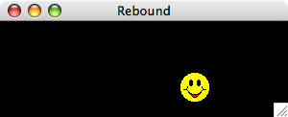
6.2 – Rebound Application

Slide 46
6.2 – Rebound.java
//********************************************************************
// Rebound.java Java Foundations
//
// Demonstrates an animation and the use of the Timer class.
//********************************************************************
import java.awt.*;
import java.awt.event.*;
import javax.swing.*;
public class Rebound
{
//-----------------------------------------------------------------
// Displays the main frame of the program.
//-----------------------------------------------------------------
public static void main (String[] args)
{
JFrame frame = new JFrame ("Rebound");
frame.setDefaultCloseOperation (JFrame.EXIT_ON_CLOSE);
frame.getContentPane().add(new ReboundPanel());
frame.pack();
frame.setVisible(true);
}
}

Slide 47
6.2 – ReboundPanel.java
//********************************************************************
// ReboundPanel.java Java Foundations
//
// Represents the primary panel for the Rebound program.
//********************************************************************
import java.awt.*;
import java.awt.event.*;
import javax.swing.*;
public class ReboundPanel extends JPanel
{
private final int WIDTH = 300, HEIGHT = 100;
private final int DELAY = 20, IMAGE_SIZE = 35;
private ImageIcon image;
private Timer timer;
private int x, y, moveX, moveY;
(more…)

Slide 48
6.2 – ReboundPanel.java
//-----------------------------------------------------------------
// Sets up the panel, including the timer for the animation.
//-----------------------------------------------------------------
public ReboundPanel()
{
timer = new Timer(DELAY, new ReboundListener());
image = new ImageIcon ("happyFace.gif");
x = 0;
y = 40;
moveX = moveY = 3;
setPreferredSize (new Dimension(WIDTH, HEIGHT));
setBackground (Color.black);
timer.start();
}
(more…)

Slide 49
6.2 – ReboundPanel.java
//-----------------------------------------------------------------
// Draws the image in the current location.
//-----------------------------------------------------------------
public void paintComponent (Graphics page)
{
super.paintComponent (page);
image.paintIcon (this, page, x, y);
}
(more…)

Slide 50
6.2 – ReboundPanel.java
//*****************************************************************
// Represents the action listener for the timer.
//*****************************************************************
private class ReboundListener implements ActionListener
{
//--------------------------------------------------------------
// Updates the position of the image and possibly the direction
// of movement whenever the timer fires an action event.
//--------------------------------------------------------------
public void actionPerformed (ActionEvent event)
{
x += moveX;
y += moveY;
if (x <= 0 || x >= WIDTH-IMAGE_SIZE)
moveX = moveX * -1;
if (y <= 0 || y >= HEIGHT-IMAGE_SIZE)
moveY = moveY * -1;
repaint();
}
}
}

Slide 51
Outline
GUI Elements
More Components
Layout Managers
Mouse and Key Events
Dialog Boxes
Important Details
GUI Design

Slide 52
6.3 – Layout Managers
Every container is managed by an object known as a layout manager that determines how the components in the container are arranged visually
The layout manager is consulted when needed, such as when the container is resized or when a component is added
Every container has a default layout manager, but we can replace it if desired
A layout manager determines the size and position of each component

Slide 53
6.3 – Predefined Layout Managers
Layout Manager | Description
Border Layout | Organizes components into five areas (North, South, East, West, and Center)
Box Layout | Organizes components into a single row or column
Card Layout | Organizes components into one area such that only one area is visible at a time
Flow Layout | Organizes components from left to right, starting new rows as necessary
Grid Layout | Organizes components into a grid of rows and columns
GridBag Layout | Organizes components into a grid of cells, allowing components to span more than one cell

Slide 54
6.3 – Layout Managers
Every layout manager has its own rules and properties governing the layout of the components it contains
For some layout managers, the order in which you add the components affects their positioning
We use the setLayout method of a container to change its layout manager

Slide 55
6.3 – Flow Layout
One of the easiest layout managers to use
The JPanel class uses flow layout by default
Puts as many components as possible on a row, at their preferred size
When a component can not fit on a row, it is put on the next row

Slide 56
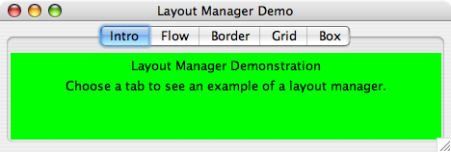
6.3 – Layout Manager Demo

Slide 57
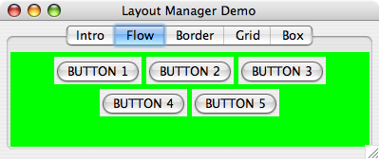
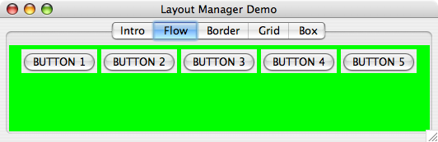
6.3 – Layout Manager Demo

Slide 58
6.3 – LayoutDemo.java
//********************************************************************
// LayoutDemo.java Java Foundations
//
// Demonstrates the use of flow, border, grid, and box layouts.
//********************************************************************
import javax.swing.*;
public class LayoutDemo
{
//-----------------------------------------------------------------
// Sets up a frame containing a tabbed pane. The panel on each
// tab demonstrates a different layout manager.
//-----------------------------------------------------------------
public static void main (String[] args)
{
JFrame frame = new JFrame ("Layout Manager Demo");
frame.setDefaultCloseOperation (JFrame.EXIT_ON_CLOSE);
(more…)

Slide 59
6.3 – LayoutDemo.java
JTabbedPane tp = new JTabbedPane();
tp.addTab ("Intro", new IntroPanel());
tp.addTab ("Flow", new FlowPanel());
tp.addTab ("Border", new BorderPanel());
tp.addTab ("Grid", new GridPanel());
tp.addTab ("Box", new BoxPanel());
frame.getContentPane().add(tp);
frame.pack();
frame.setVisible(true);
}
}

Slide 60
6.3 – IntroPanel.java
//********************************************************************
// IntroPanel.java Java Foundations
//
// Represents the introduction panel for the LayoutDemo program.
//********************************************************************
import java.awt.*;
import javax.swing.*;
public class IntroPanel extends JPanel
{
//-----------------------------------------------------------------
// Sets up this panel with two labels.
//-----------------------------------------------------------------
public IntroPanel()
{
setBackground (Color.green);
JLabel l1 = new JLabel ("Layout Manager Demonstration");
JLabel l2 = new JLabel ("Choose a tab to see an example of " +
"a layout manager.");
add (l1);
add (l2);
}
}

Slide 61
6.3 – FlowPanel.java
//********************************************************************
// FlowPanel.java Java Foundations
//
// Represents the panel in the LayoutDemo program that demonstrates
// the flow layout manager.
//********************************************************************
import java.awt.*;
import javax.swing.*;
public class FlowPanel extends JPanel
{
//-----------------------------------------------------------------
// Sets up this panel with some buttons to show how flow layout
// affects their position.
//-----------------------------------------------------------------
public FlowPanel ()
{
setLayout (new FlowLayout());
setBackground (Color.green);
(more…)

Slide 62
6.3 – FlowPanel.java
JButton b1 = new JButton ("BUTTON 1");
JButton b2 = new JButton ("BUTTON 2");
JButton b3 = new JButton ("BUTTON 3");
JButton b4 = new JButton ("BUTTON 4");
JButton b5 = new JButton ("BUTTON 5");
add (b1);
add (b2);
add (b3);
add (b4);
add (b5);
}
}

Slide 63
6.3 – Border Layout
A border layout has five areas to which components can be added: North, South, East, West, and Center
The four outer areas are as large as needed in order to accommodate the component they contain
If no components are added to a region, the region takes up no room in the overall layout
The Center area expands to fill any available space

Slide 64
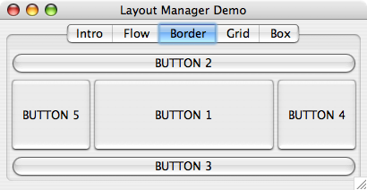
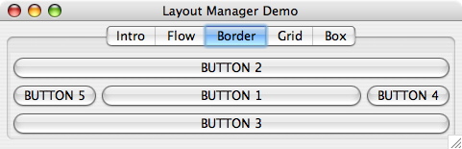
6.3 – Layout Manager Demo

Slide 65
6.3 – BorderPanel.java
//********************************************************************
// BorderPanel.java Java Foundations
//
// Represents the panel in the LayoutDemo program that demonstrates
// the border layout manager.
//********************************************************************
import java.awt.*;
import javax.swing.*;
public class BorderPanel extends JPanel
{
//-----------------------------------------------------------------
// Sets up this panel with a button in each area of a border
// layout to show how it affects their position, shape, and size.
//-----------------------------------------------------------------
public BorderPanel()
{
setLayout (new BorderLayout());
setBackground (Color.green);
(more…)

Slide 66
6.3 – BorderPanel.java
JButton b1 = new JButton ("BUTTON 1");
JButton b2 = new JButton ("BUTTON 2");
JButton b3 = new JButton ("BUTTON 3");
JButton b4 = new JButton ("BUTTON 4");
JButton b5 = new JButton ("BUTTON 5");
add (b1, BorderLayout.CENTER);
add (b2, BorderLayout.NORTH);
add (b3, BorderLayout.SOUTH);
add (b4, BorderLayout.EAST);
add (b5, BorderLayout.WEST);
}
}

Slide 67
6.3 – Grid Layout
A grid layout presents a container’s components in a rectangular grid of rows and columns
One component is placed in each cell, and all cells are the same size
The number of rows and columns in a grid layout is established by using parameters to the constructor when the layout manager is created

Slide 68
6.3 – Grid Layout
As components are added to the grid layout, they fill the grid from left to right, top to bottom
There is no way to explicitly assign a component to a particular location in the grid other than the order in which they are added to the container

Slide 69
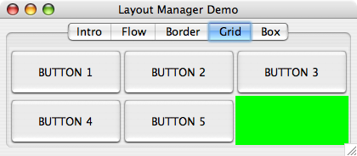
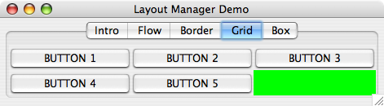
6.3 – Layout Manager Demo

Slide 70
6.3 – Box Layout
A box layout organizes components either vertically or horizontally, in one row or one column
It is easy to use and when combined with other layout managers, can produce complex GUI designs
Components are organized in the order in which they are added to the container
There are no gaps between the components in a box layout

Slide 71
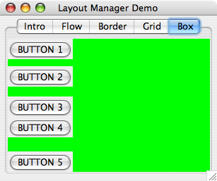
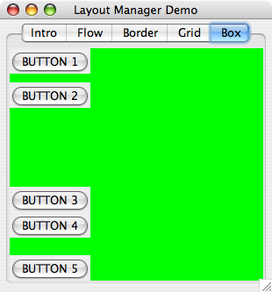
6.3 – Layout Manager Demo

Slide 72
6.3 – Containment Hierarchies
The way components are grouped into containers, and the way those containers are nested within each other, establishes the containment hierarchy for a GUI
For any Java GUI program, there is generally one primary (top-level) container, such as a frame or applet
The top-level container often contains one or more containers, such as panels
These panels may contain other panels to organize the other components as desired

Slide 73
Outline
GUI Elements
More Components
Layout Managers
Mouse and Key Events
Dialog Boxes
Important Details
GUI Design

Slide 74
6.4 – Mouse and Key Events
Events are also fired when a user interacts with the computer’s mouse and keyboard
Mouse events
  mouse events – occur when the user interacts with another component via the mouse. To use, implement the MouseListener interface class
  mouse motion events – occur while the mouse is in motion. To use, implement the MouseMotionListener interface class

Slide 75
6.4 – Mouse Events
Mouse Event | Description
mouse pressed | The mouse button is pressed down
mouse released | The mouse button is released
mouse clicked | The mouse button is pressed down and released without moving the mouse in between
mouse entered | The mouse pointer is moved onto (over) a component
mouse exited | The mouse pointer is moved off of a component
Mouse Motion Event | Description
mouse moved | The mouse is moved
mouse dragged | The mouse is moved while the mouse button is pressed down

Slide 76
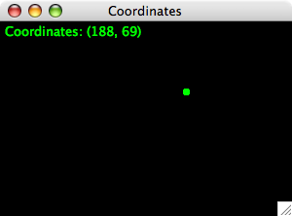
6.4 – Coordinates Application

Slide 77
6.4 – CoordinatesPanel.java
//********************************************************************
// CoordinatesPanel.java Java Foundations
//
// Represents the primary panel for the Coordinates program.
//********************************************************************
import javax.swing.JPanel;
import java.awt.*;
import java.awt.event.*;
public class CoordinatesPanel extends JPanel
{
private final int SIZE = 6; // diameter of dot
private int x = 50, y = 50; // coordinates of mouse press
//-----------------------------------------------------------------
// Constructor: Sets up this panel to listen for mouse events.
//-----------------------------------------------------------------
public CoordinatesPanel()
{
addMouseListener (new CoordinatesListener());
setBackground (Color.black);
setPreferredSize (new Dimension(300, 200));
}
(more…)

Slide 78
6.4 – CoordinatesPanel.java
//-----------------------------------------------------------------
// Draws all of the dots stored in the list.
//-----------------------------------------------------------------
public void paintComponent (Graphics page)
{
super.paintComponent(page);
page.setColor (Color.green);
page.fillOval (x, y, SIZE, SIZE);
page.drawString ("Coordinates: (" + x + ", " + y + ")", 5, 15);
}
(more…)

Slide 79
6.4 – CoordinatesPanel.java
//*****************************************************************
// Represents the listener for mouse events.
//*****************************************************************
private class CoordinatesListener implements MouseListener
{
//--------------------------------------------------------------
// Adds the current point to the list of points and redraws
// the panel whenever the mouse button is pressed.
//--------------------------------------------------------------
public void mousePressed (MouseEvent event)
{
x = event.getX();
y = event.getY();
repaint();
}
//--------------------------------------------------------------
// Provide empty definitions for unused event methods.
//--------------------------------------------------------------
public void mouseClicked (MouseEvent event) {}
public void mouseReleased (MouseEvent event) {}
public void mouseEntered (MouseEvent event) {}
public void mouseExited (MouseEvent event) {}
}
}

Slide 80
6.4 – Key Events
A key event is generated when the user presses a keyboard key
This allows a program to respond immediately to the user while they are typing or pressing other keyboard keys (such as the arrow or function keys)
In the example starting on the next slide, our DirectionListener class implements the KeyListener interface
KeyListener defines three methods used to respond to keyboard activity

Slide 81
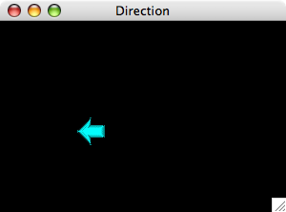
6.4 – Direction Application

Slide 82
6.4 – Extending Adapter Classes
In our previous examples, we’ve created the listener classes by implementing a particular listener interface
An alternative technique for creating a listener class is to use inheritance and extend an adapter class
Each listener interface that contains more than one method has a corresponding adapter class containing empty definitions for all methods in the interface
We can override any event methods we need in our new child class

Slide 83
6.4 – Extending Adapter Classes
Example
  The MouseAdapter class implements the MouseListener interface class and provides empty method definitions for the five mouse event methods
  By subclassing MouseAdapter, we can avoid implementing the interface directly
This approach can save us coding time and keep our source code easier to read

Slide 84
Outline
GUI Elements
More Components
Layout Managers
Mouse and Key Events
Dialog Boxes
Important Details
GUI Design

Slide 85
6.5 – Dialog Boxes
A dialog box is a graphical window that pops up on top of any currently active window so that the user can interact with it
A dialog box can serve a variety of purposes
  conveying information
  confirming an action
  permitting the user to enter information
The JOptionPane class simplifies the creation and use of basic dialog boxes

Slide 86
6.5 – Dialog Boxes
JOptionPane dialog boxes fall into three categories
  message dialog boxes – used to display an output string
  input dialog boxes – presents a prompt and a single input txt file into which the user can enter one string of data
  confirm dialog box – presents the user with a simple yes-or-no question
These three basic types of dialog boxes are easily created using static methods in the JOptionPane class
Many of the JOptionPane methods allow the program to tailor the contents of the dialog box

Slide 87
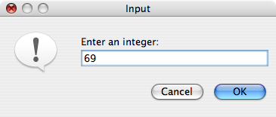
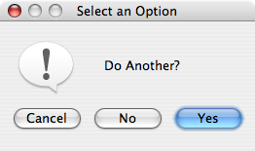
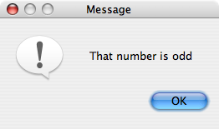
6.5 – Dialog Boxes

Slide 88
6.4 – EvenOdd.java
//********************************************************************
// EvenOdd.java Java Foundations
//
// Demonstrates the use of the JOptionPane class.
//********************************************************************
import javax.swing.JOptionPane;
public class EvenOdd
{
//-----------------------------------------------------------------
// Determines if the value input by the user is even or odd.
// Uses multiple dialog boxes for user interaction.
//-----------------------------------------------------------------
public static void main (String[] args)
{
String numStr, result;
int num, again;
(more…)

Slide 89
6.4 – EvenOdd.java
do
{
numStr = JOptionPane.showInputDialog ("Enter an integer: ");
num = Integer.parseInt(numStr);
result = "That number is " + ((num%2 == 0) ? "even" : "odd");
JOptionPane.showMessageDialog (null, result);
again = JOptionPane.showConfirmDialog (null, "Do Another?");
}
while (again == JOptionPane.YES_OPTION);
}
}

Slide 90
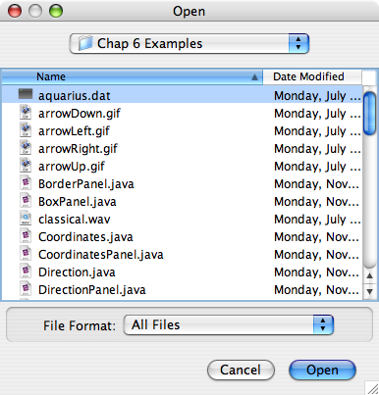
6.4 – File Choosers
A file chooser is a specialized dialog box used to select a file from a disk or other storage medium
The dialog automatically presents a standardized file selection window
Filters can be applied to the file chooser programmatically
The JFileChooser class creates this type of dialog box

Slide 91
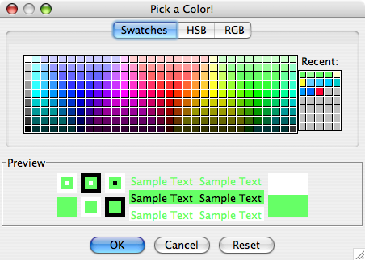
6.4 – Color Choosers
A color chooser dialog box can be displayed, permitting the user to select color from a list
The JColorChooser represents a color chooser dialog box
The user can also specify a color using RGB values

Slide 92
Outline
GUI Elements
More Components
Layout Managers
Mouse and Key Events
Dialog Boxes
Important Details
GUI Design

Slide 93
6.6 - Borders
Java provides the ability to put a border around any Swing component
A border is not a component but defines how the edge of a component should be drawn
Border provide visual cues as to how GUI components are organized
The BorderFactory class is useful for creating borders for components

Slide 94
6.6 - Borders
Border | Description
Empty Border | Puts a buffering space around the edge of a component, but otherwise has no visual effect
Line Border | A simple line surrounding the component
Etched Border | Creates the effect of an etched groove around a component
Bevel Border | Creates the effect of a component raised above the surface or sunken below it
Titled Border | Includes a text title on or around the border
Matte Border | Allows the size of each edge to be specified. Uses either a solid color or an image
Compound Border | A combination of two borders

Slide 95
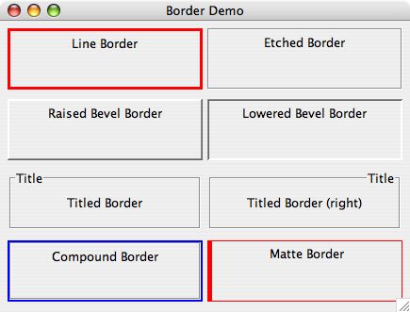
6.6 - Borders

Slide 96
6.6 – Tool Tips
A tool tip is a short line of text that appears over a component when the mouse cursor is rested momentarily on top of the component
Tool tips usually inform the user about the component
Tool tips can be assigned by using the setToolTipText method of a component
JButton button = new Button (“Compute”);
button.setToolTipText (“Calculates the area under the curve”);

Slide 97
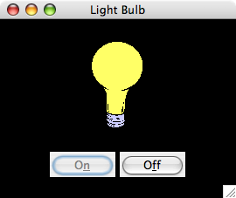
6.6 - Mnemonics
A mnemonic is a character that allows the user to push a button or make a menu choice using the keyboard in addition to the mouse
For example, when a mnemonic has been defined for a button, the user can hold down the Alt key and press the mnemonic character to activate (depress) the button
We set the mnemonic for a component using the setMnemonic method of the component
Once set, a character in the label will be underlined to indicate that it can be used as a shortcut
Mnemonic character ‘f’ set for the Off button

Slide 98
Outline
GUI Elements
More Components
Layout Managers
Mouse and Key Events
Dialog Boxes
Important Details
GUI Design

Slide 99
6.7 – GUI Design
Keep in mind our goal is to solve a problem
Fundamental ideas of good GUI design include
  knowing the user
  preventing user errors
  optimizing user abilities
  being consistent
We should design interfaces so that the user can make as few mistakes as possible

Slide 100
Chapter 6 – Summary
Chapter 6 focused on
  discussing the core elements: components, events, and listeners
  discussing the concept of a layout manager
  examining mouse and keyboard events
  describing tool tips and mnemonics
  discussing GUI design issues

